Slide 1
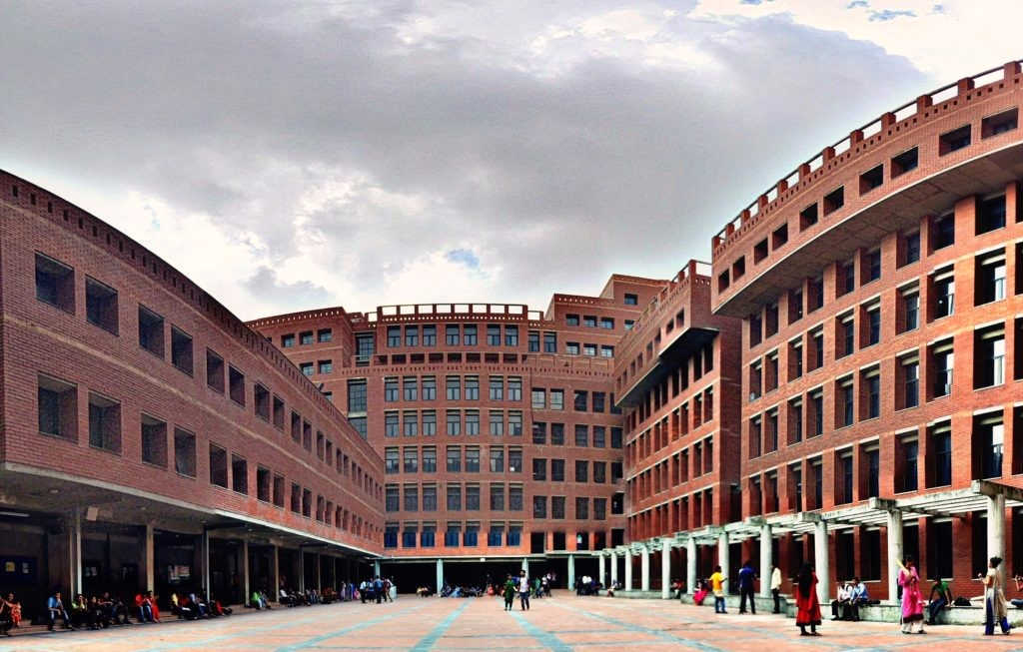
Hello everyone

Slide 2
Submitted By
MD. ALI HAIDAR
(2022-1-960-193)
MD. TANVIR HOSSAIN
(2022-1-60-196)
name
(2022-1-60-000)
name
(2022-1-60-000)
Submitted To
Nishat Tasnim Niloy
Department of Computer Science and Engineering

Slide 3
SHOP
AMAR DOKAN Online Shopping Platform

Slide 4

Welcome to AMAR DOKAN , your one-stop online shopping destination offering a wide
range of high-quality products at great prices. Our user-friendly platform provides a
seamless shopping experience with secure payment options, fast delivery, and detailed
product information. We are dedicated to customer satisfaction, making it easy and
enjoyable for you to shop with us. Discover a world of convenience and
variety—shop with us today!

Slide 5
Features
PAY
User friendly interface
01
Easy navigation with well-organized categories, simple and effective search functionality
02
Secure Payment Option
Bkash payment system
Product Catelog
03
A variety of categories and products available for shopping
Shopping Cart and Checkout
04
Add/remove items and view totals before checking out.

Slide 6
Additional Features
Search
User Account
Discounts and Offers
Return & Refund Policy
Search by product name
Secure customer login to manage orders
Support for discounts, seasonal sales
Clear instructions for returning items

Slide 7
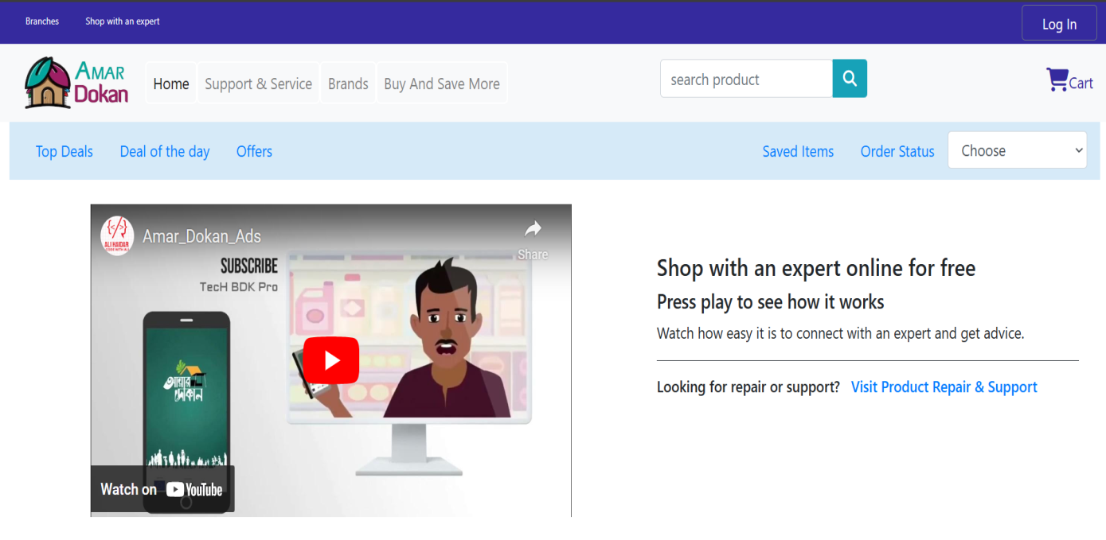
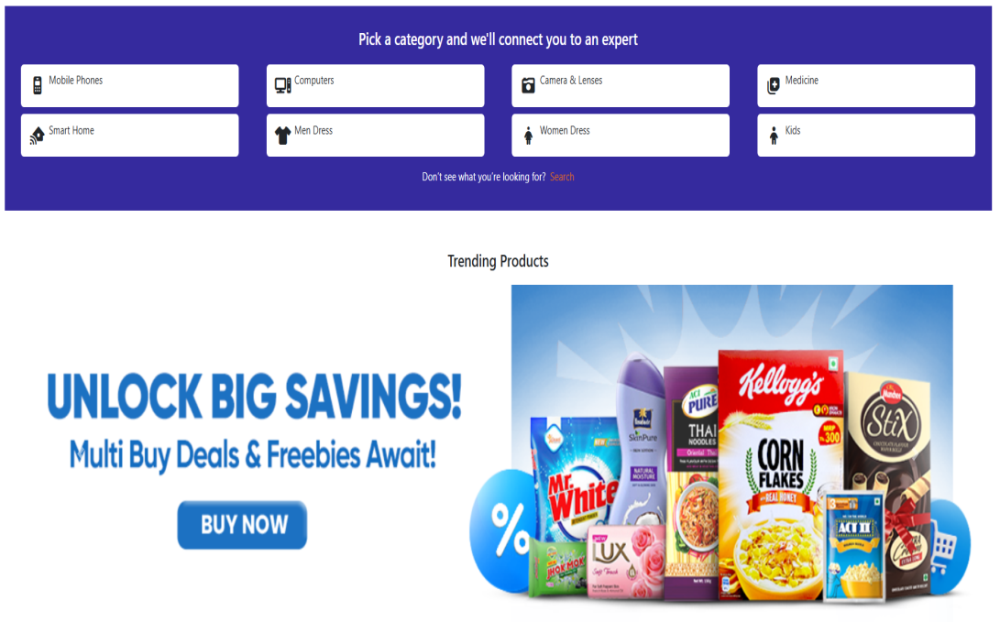
User Interface
Home Page

Slide 8
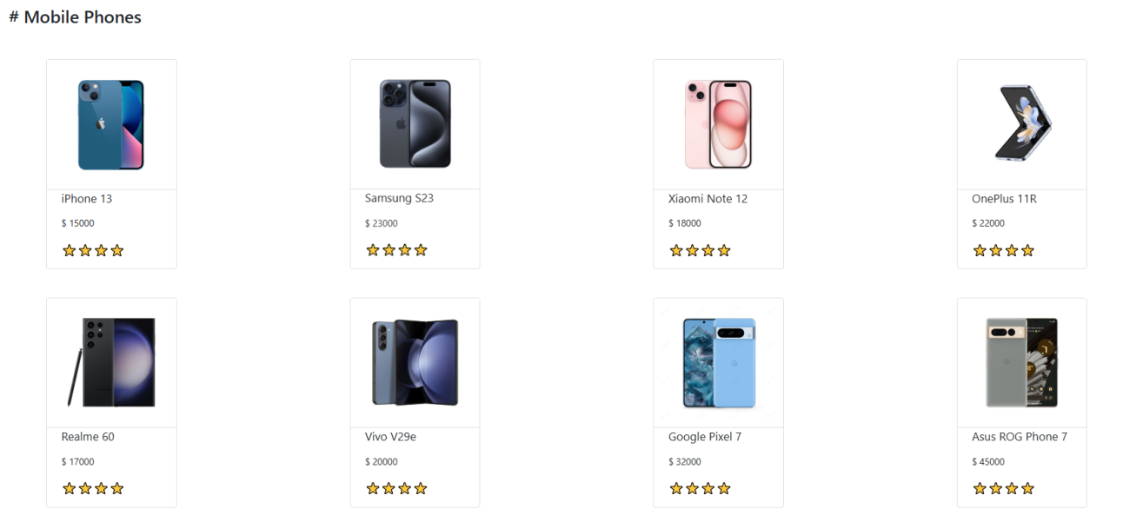
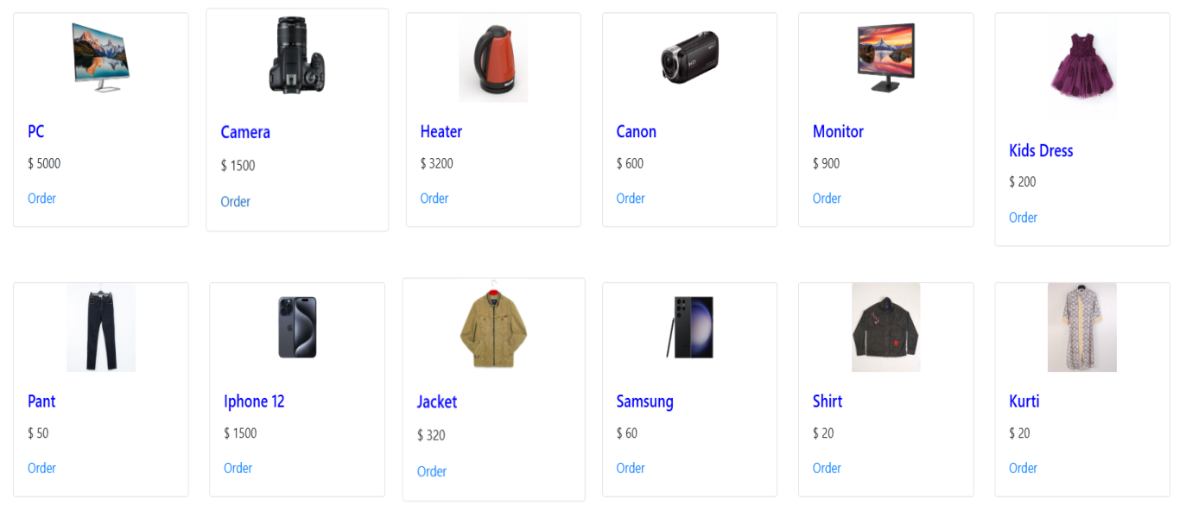
User Interface

Slide 9
To Order a Product
01
04
Login
Delivery
First you have to login in your own account.
At the last you will find your desire product
01
04
ORDER
02
02
03
03
Product
Payment
Then you will select the product of your choice.
Complete the payment of product

Slide 10
Upcomming Features
A
B
C
D
More Payment Options
Improved Search Functionality
Chatbot
New Product Categories

Slide 11

Thank You for taking the time to learn more about our Website. We look forward to continuing to exceed your expectations and become your go-to destination for all your shopping needs.

